Slide 2
AAUW OF IOWA SPRING CONFERENCE APRIL 26, 2025
DIFFICULT CONVERSATIONS
TIPS TO BE BOLD

Slide 3
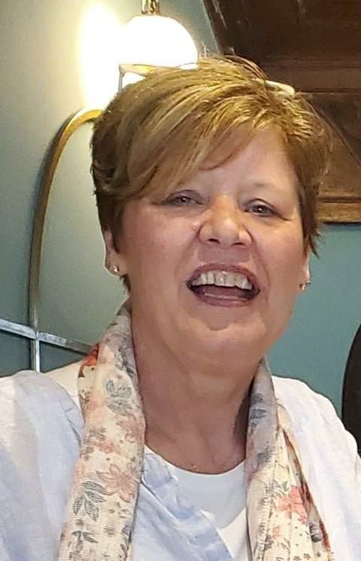
SUSAN LANGAN CEDAR FALLS-WATERLOO
AAUW MEMBER and DIVERSITY OFFICER
RETIRED SCHOOL COUNSELOR WIFE, SISTER, AUNT, FRIEND

Slide 4
How many of you have had a difficult conversation recently? This could be with friends, family, or colleagues.
Conversations can spring to life in so many different settings—whether it's a light-hearted chat with friends, a heartfelt discussion with family, or a brainstorming session with colleagues. Each interaction brings its own unique vibe and energy, turning ordinary moments into memorable exchanges.
TABLE TALK

Slide 5
Sometimes, conversations change in unexpected ways. This can help us discover new ideas or viewpoints that we might not agree with.
It’s interesting to think about how we feel in these moments.
Do we decide to share our thoughts, or do we choose to listen quietly?
Engaging in these discussions can really improve our understanding and connections with others!

Slide 6
We will learn 5 principles to have bold conversations. #1 Self examine by honestly asking yourself whether in fact you have an agenda.
#2 Be curious
#3 Listen with an intent to understand
#4 You may react to what the other person is saying with confusion, anger or frustration. That is NORMAL. #5 The point is not to win the argument but to increase awareness.

Slide 7
Thank you Maria and Lori!!
Conversation #1

Slide 8
Cognitive bias
The discomfort you feel when presented with ideas that conflict with your values or beliefs. We double down or get defensive.
If I am late, there is a good reason. If someone else is late, they are lazy or unorganized.
Attribution bias

Slide 9
When we are stuck….
How clearly did we state your position?
How fairly and thoroughly can you state the other side?
Are there other perspectives that provide a broader perspective?

Slide 10
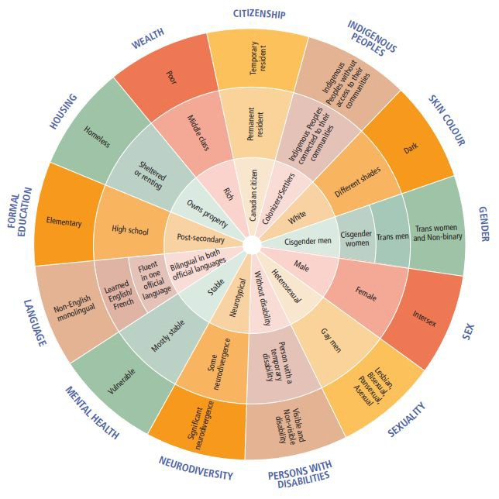
#1 Principle Self examine for an
agenda
Positionality and self
reflection
Wheel of privilege and
power

Slide 11
TABLE TALK

Slide 12
Principle #2 Be Curious
Curiosity helps to strengthen
relationships
Curiosity has a positive effective on developing interpersonal closeness
Curiosity improves healthcare
outcomes

Slide 13
TABLE TALK

Slide 14
Principle #3 Listen with intent to understand
Helping ourselves and our members through conflict
conversations
Pausing before reacting and
reflecting

Slide 15
TABLE TALK

Slide 16
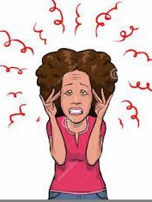
Principle #4 Frustration is normal
Take a relaxed approach to the conversation. Helps with reasoning and
understanding
Start a conversation with neutral questions
Being aware of the surroundings (home, workplace, social, community)
Being aware of conversation timing and
other preferences

Slide 17
TABLE TALK

Slide 18
Principle #5 The point is not to win the argument but to raise awareness
Increasing awareness means understanding differences
Beliefs and actions tend to come from people’s backgrounds
Acceptance works both ways
I can control my reactions and responses but I cannot control others

Slide 19
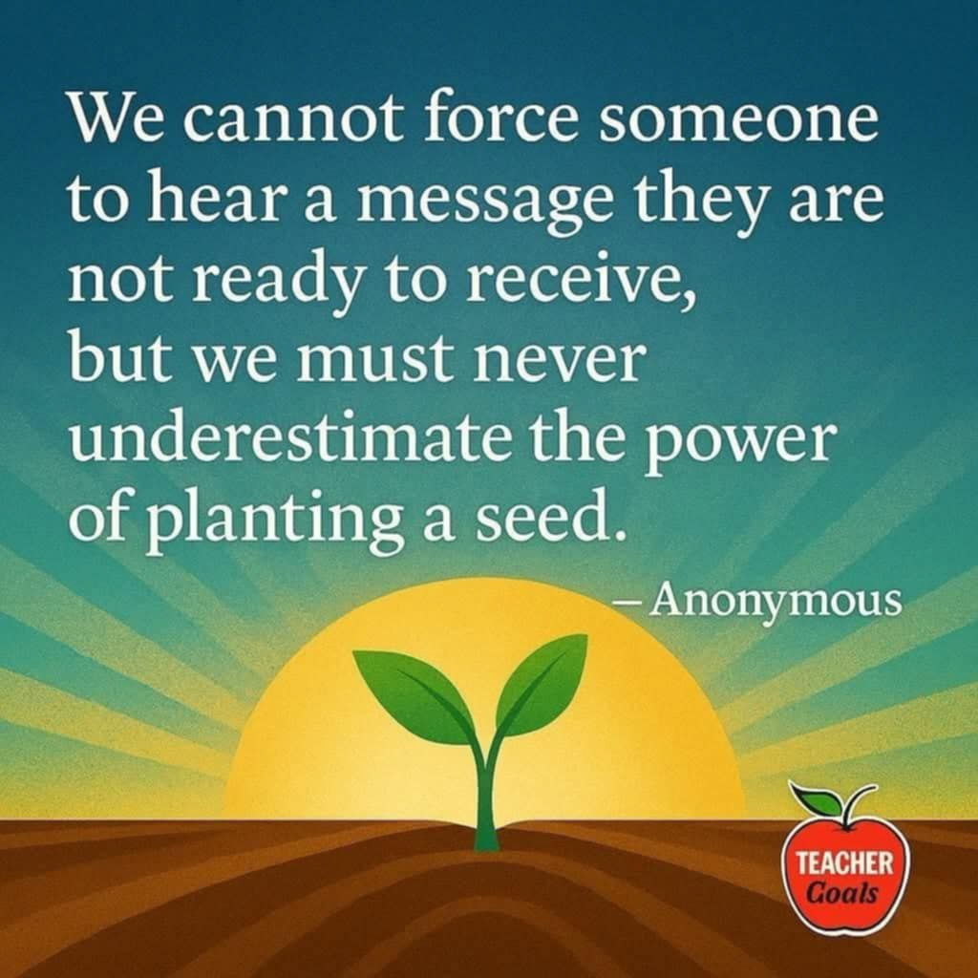

Slide 20
TABLE TALK

Slide 21
★ Making space for different
perspectives
★ Consciously create an environment for participants to
feel comfortable
★ Become aware of cultural norms and values that may shape
others’ perspectives.

Slide 22
Thank you Maria and Lori!!
Conversation #2

Slide 23
TIPS TO REMEMBER
★ IT TAKES TIME TO PROCESS NEW OR DIFFERENT INFORMATION
★ OTHER FACTORS ALSO PLAY A ROLE IN HOW A PERSON PROCESSES INFORMATION
★ IT TAKES TIME TO UNDERSTAND EACH OTHER
★ SOME MATTERS REQUIRE MORE THAN ONE CONVERSATION
★ HAVING CIVIL CONVERSATIONS HELPS BOTH PARTIES IN THE CONVERSATION
★ AAUW CIVILITY POLICY

Slide 24
Resources available on AAUW website

Slide 25
Questions? Comments? Suggestions?

Slide 26
THANK YOU!!

